Slide 1



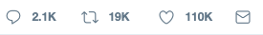
Sentiment Analysis of Tweets using Tweepy
Lillian Bolfer - Dinielle Nelson - Elizabeth Jaye
@SentimentAnalysis
Sentiment Analysis of Netflix Tweets Using Tweepy and TextBlob #GitSomeData #WorthHiring #WomenWhoCode

Slide 2
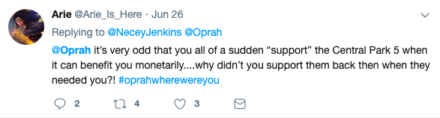

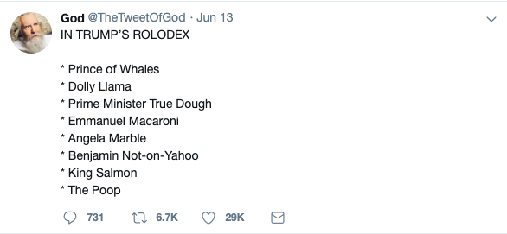
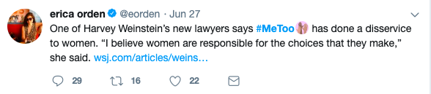
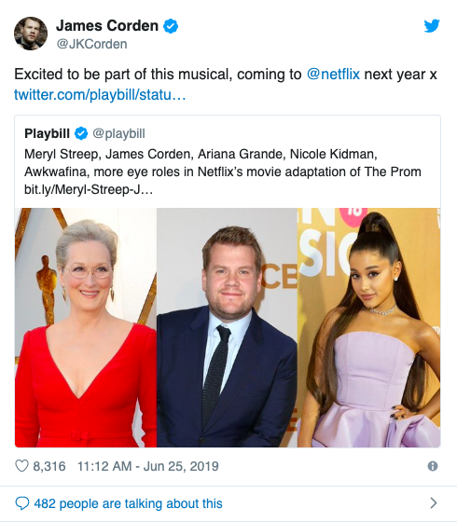
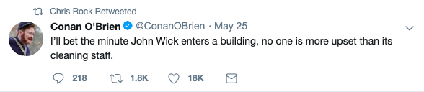
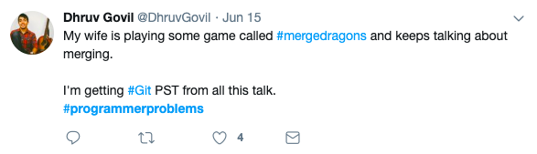
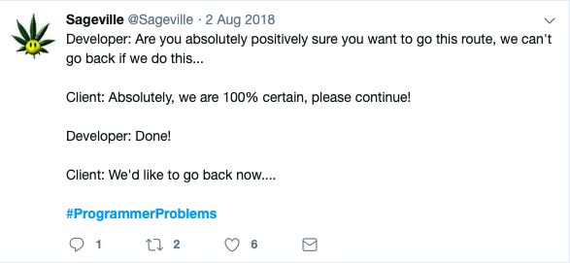
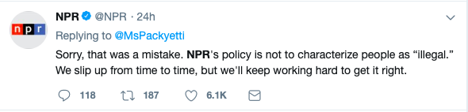
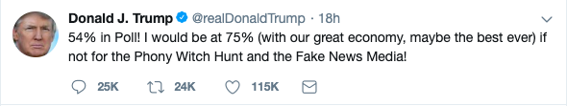
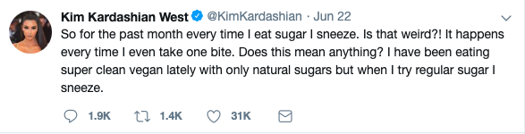

Slide 5
https://github.com/lillianbolfer/SentimentAnalysis
https://public.tableau.com/profile/lillian.bolfer#!/vizhome/SentimentAnalysis2/Dashboard1?publish=yes

